Slide 1
Molecular Biology Biol 480
Lecture 22 March 22th, 2019

Slide 2
Announcements/Assignments
Real-time PCR /quantitative pcr data has been nicely organized for you. Please use the data for your group (remembering which wells belonged you your group and what went into each well).
You need to have you notebooks up to date by Monday, including this lab and data (Ct with average for triplicates) as well as the fluorescence curves).
You need to have a conclusion for this lab by Monday, although we will discuss more next Wednesday.

Slide 3
Again---Please don’t treat the lab notebooks as something you “fill in” when they are collected for grades. You need to come to lab prepared---with good understanding of previous and current lab.
We have built upon previous labs nearly every time we’ve met this semester, but have not really been able to quickly call on details of previous labs.

Slide 4
Where were we? How was the code cracked?

Slide 5
Be sure you can describe several different experimental approaches for determining general 3-letter nature of the code as well as the code assignments.
Describe “wobble” with respect to the genetic code?

Slide 6
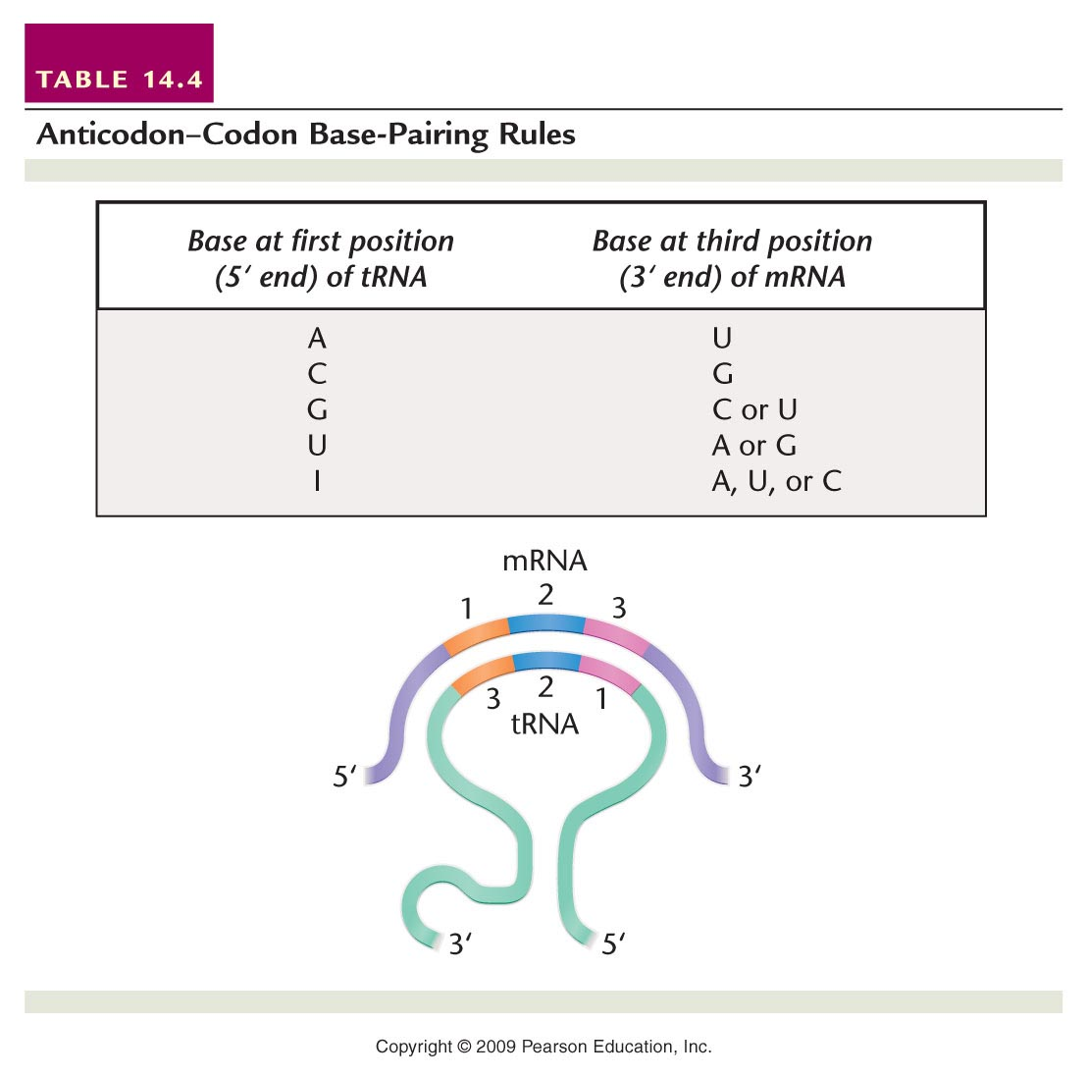
Table 14.4
Notes:
Table 14-4 Anticodon–Codon Base-Pairing Rules

Slide 7
What might this mean for cells and the tRNAs they make? Do they need to perfectly match each codon with a complementary tRNA anticodon?
Might this give organisms an economical advantage?

Slide 8
Yes!
Cells of all living things use 61 codons to encode the amino acids (3 codons signal termination of translation) of their proteins.
This should require 61 tRNAs with unique anticodon seqence….But examination of lots of living things shows they can they get by with only 30-50 different tRNAs for protein synthesis—by allowing wobble!

Slide 9
A Universal Genetic Code
What do we mean, when we say the code is universal?
What, if any, exceptions have been noted to the universality of the code?

Slide 10
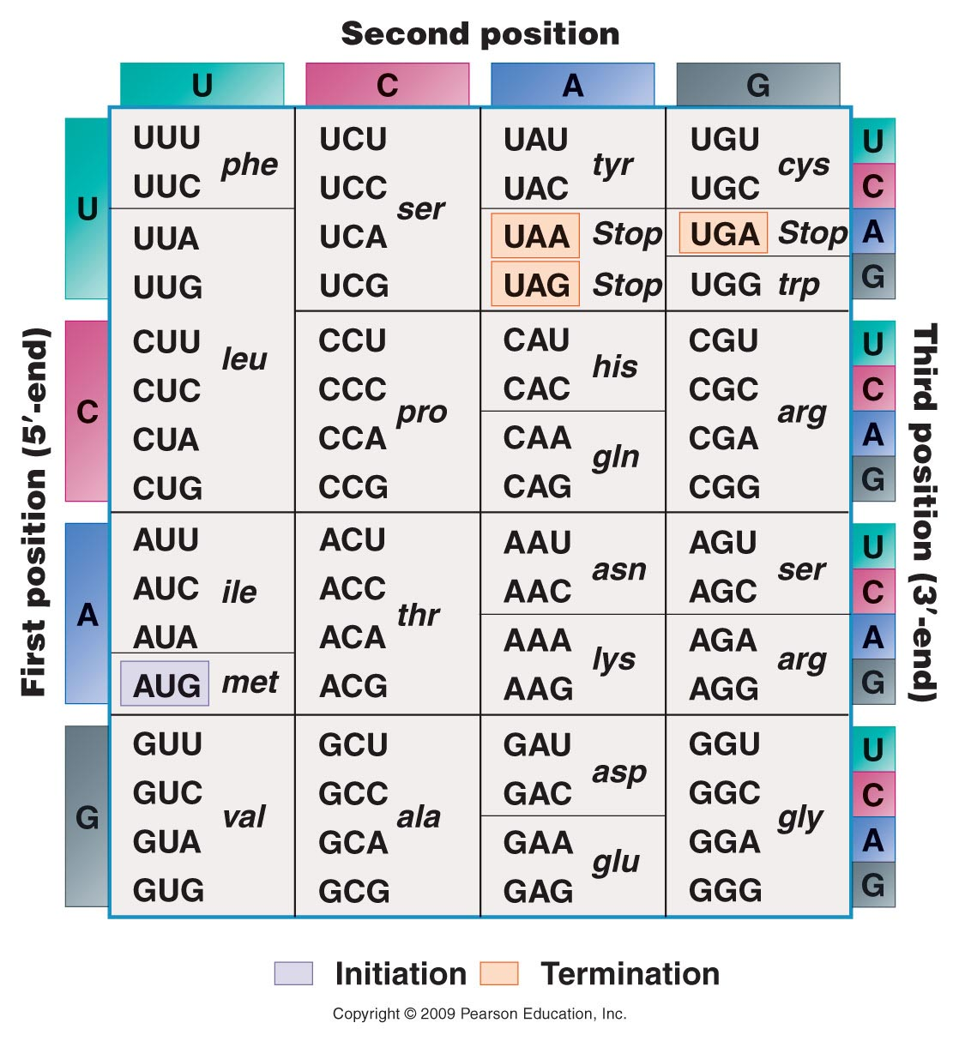
Figure 14.7
Figure 14-7 Copyright © 2006 Pearson Prentice Hall, Inc.
Notes:
Figure 14-7 The coding dictionary. AUG encodes methionine, which initiates most polypeptide chains. All other amino acids except tryptophan, which is encoded only by UGG, are represented by two to six codons. The codons UAA, UAG, and UGA are termination signals and do not encode any amino acids.

Slide 11
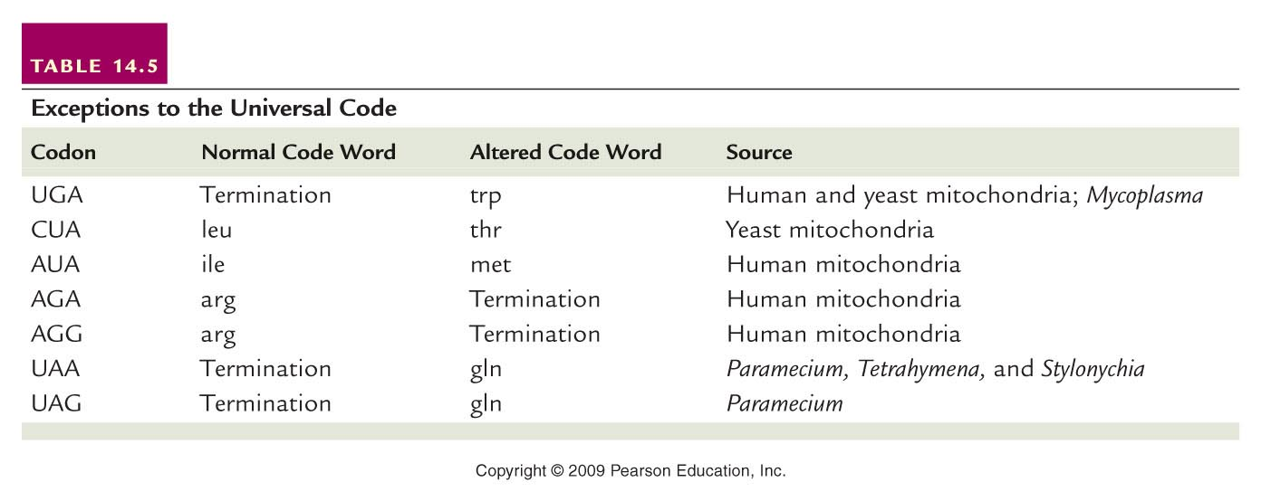
Just a few exceptions—
Again we see how mitochondria often play by slightly different rules when it comes to the central dogma.
Table 14.5
Notes:
Table 14-5 Exceptions to the Universal Code

Slide 12
Chapter 14---Translation and proteins
We’ve already mentioned quite a bit about the process of protein synthesis.
What are we referring to when we say…”protein synthesis machinery”?
A minimum of ribosomes and tRNAs! (and of course mRNA to translate)

Slide 13
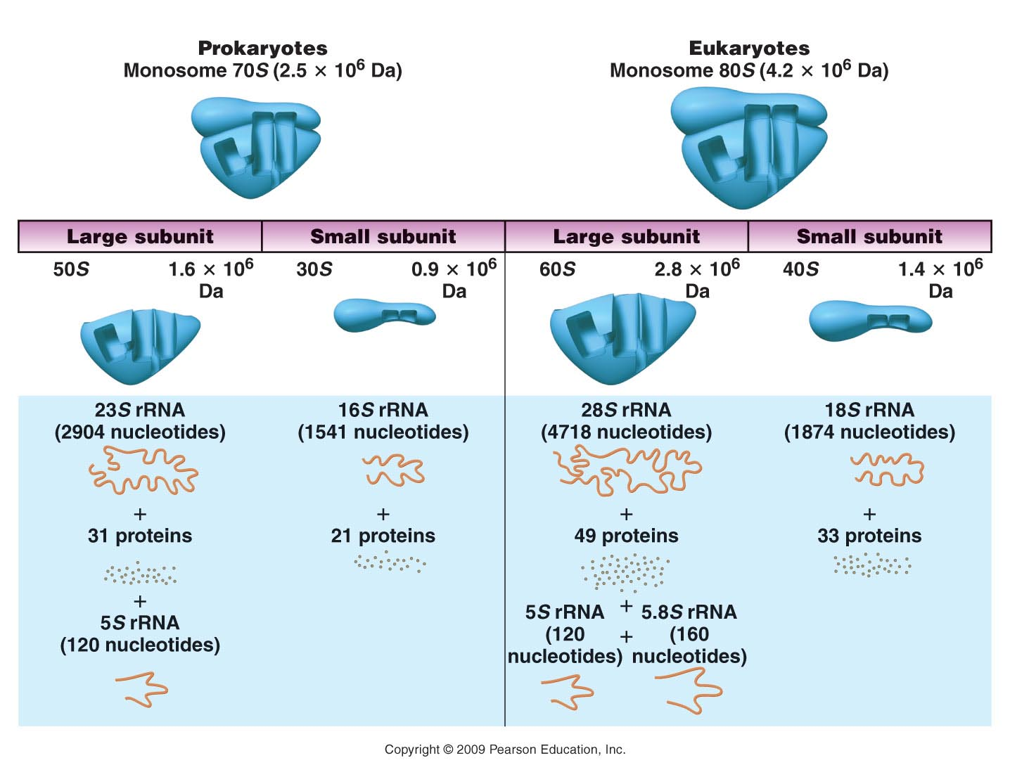
Figure 15.1
Notes:
Figure 15-1 A comparison of the components in the prokaryotic and eukaryotic ribosome.

Slide 14
Living things make a lot of proteins and thus make a lot of ribosomes.
Most of the RNA in cells is rRNA. rRNA is transcribed from DNA (rRNA genes).
E. coli has seven copies of a sequence that contains all 3 of its rRNA genes. The individual rRNAs are cut from this one longer transcript.

Slide 15
Eukaryotes usually have multiple copies of the rRNA genes.
Humans for example encode rRNAs on 5 different gene clusters on 5 different chromosomes.
We need lots and lots and lots of rRNA!

Slide 16
Ribosomal RNA is transcribed in one location in the nucleus—called the nucleolus.

Slide 17
Read More! Think and connect concepts!
http://en.wikipedia.org/wiki/Nucleolus
Pay special attention to the section called Function and Ribosome Assembly
Recall, in eukaryotes rRNA is transcribed by RNA Pol I and RNA Pol III.

Slide 18
Ribosomes are conserved structures
Since protein synthesis is so important and done virtually the same way in all organisms, from viruses to oak trees to blue whales, rRNAs and ribosomal proteins are very similar in all species.
rRNA genes have regions, though that don’t end up in the functional rRNA---these are “spacer” regions

Slide 19
rRNA spacers
Since these spacer regions are not important in the rRNA, they can vary in different species, even closely related species. (there is no evolutionary pressure to select for a specific sequence in these areas).
Both Drs. Lepp and Shipunov use these spacer sequences to try to identify species of plants and bacteria

Slide 21
Recall, both rRNA and tRNA work to translate the mRNA.

Slide 22
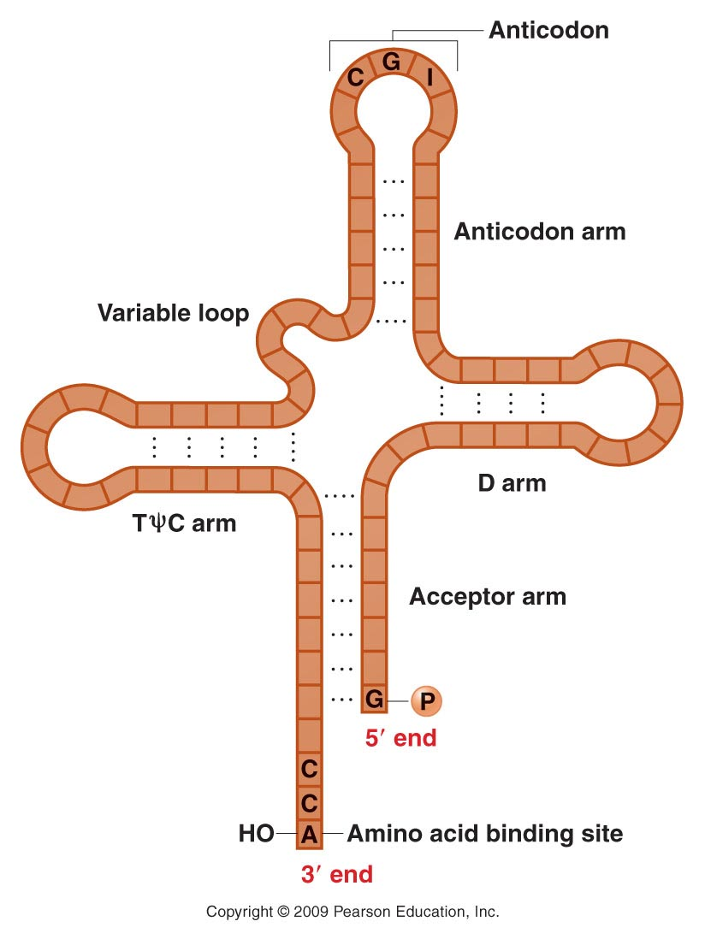
tRNA
Figure 15.3
Notes:
Figure 15-3 Holley’s two-dimensional cloverleaf model of transfer RNA.

Slide 23
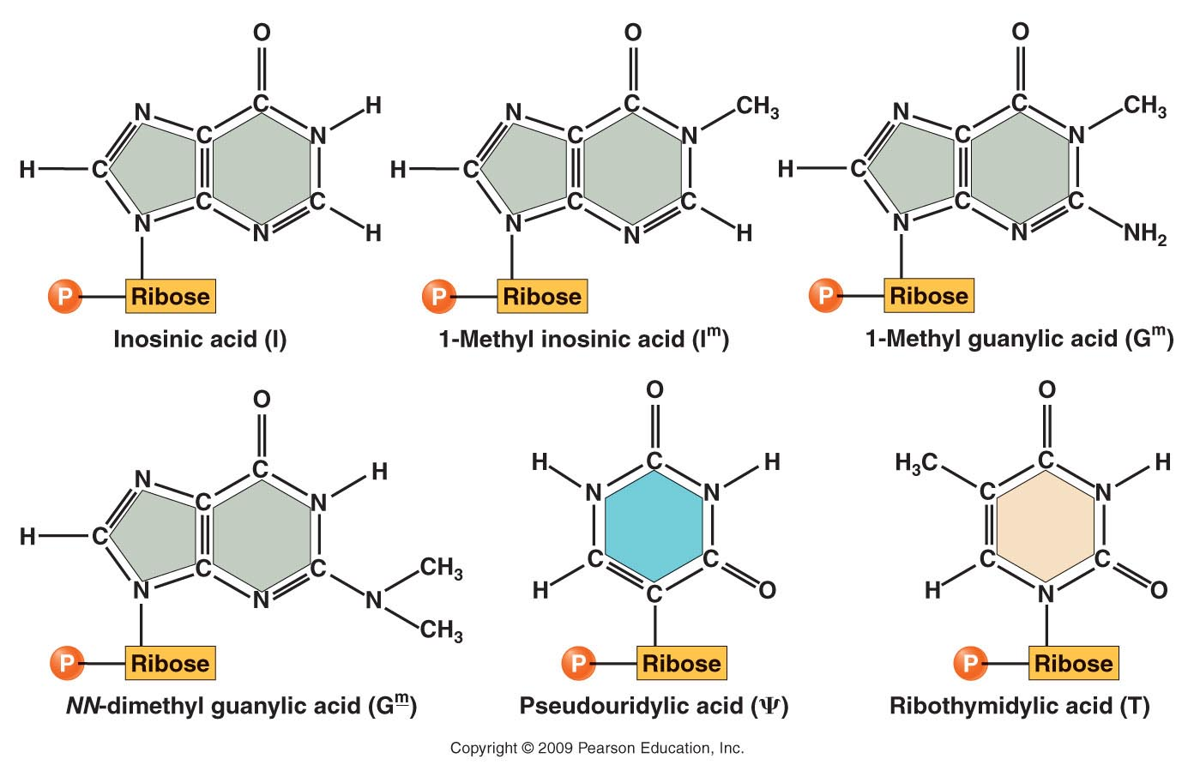
tRNA has some unusual bases in it.
Figure 15.2
Notes:
Figure 15-2 Unusual nitrogenous bases found in transfer RNA.

Slide 24
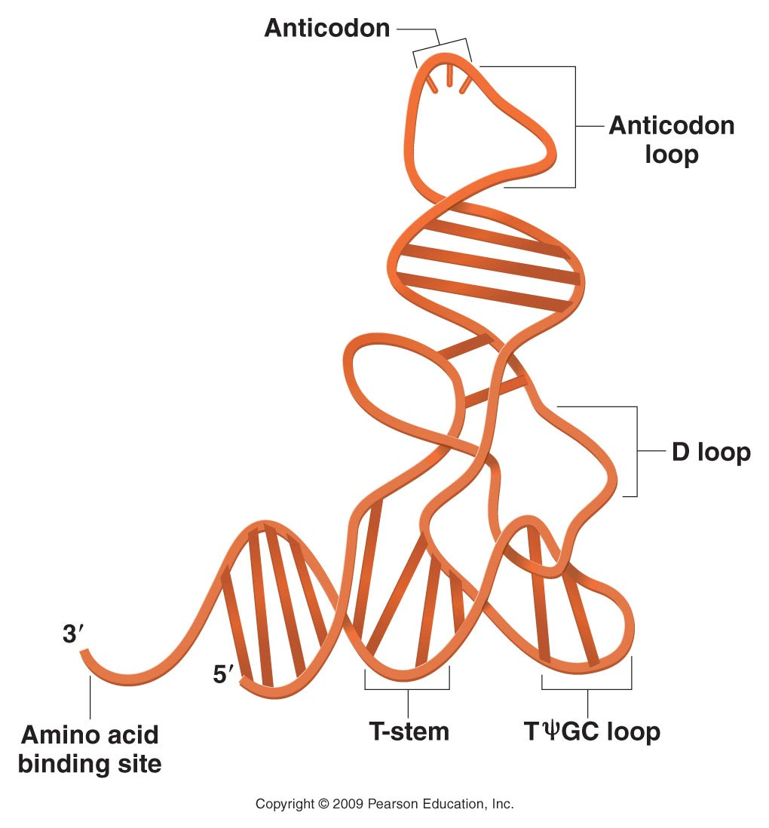
Figure 15.4
Notes:
Figure 15-4 A three-dimensional model of transfer RNA.

Slide 25
tRNA is transcribed from DNA (tRNA genes)
Like all RNAs, it is entirely nucleic acid. Only after an enzymatic reaction will a tRNA have an amino acid attached to it.
tRNAs covalently linked to amino acids are called charged tRNAs.

Slide 26
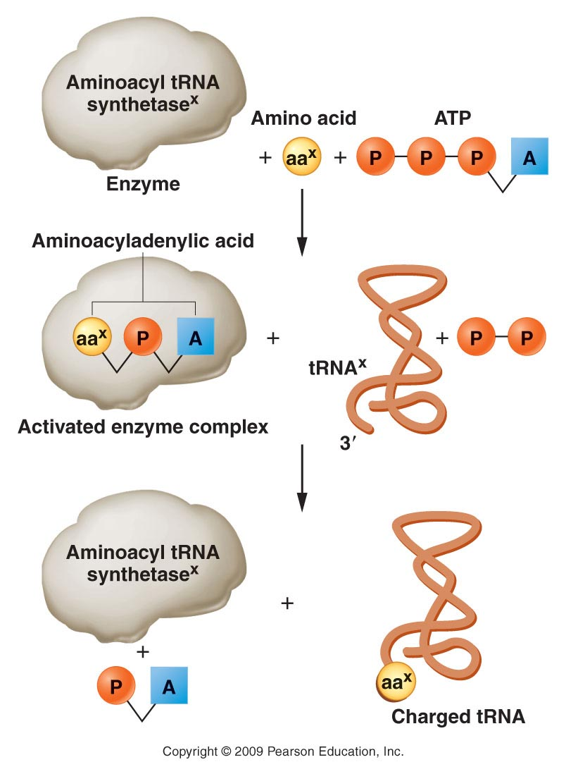
tRNA charging uses a specific
type of enzyme.
tRNA charging requires energy (ATP)
Figure 15.5
Notes:
Figure 15-5 Steps involved in charging tRNA. The “x” denotes that for each amino acid only the corresponding specific tRNA and specific aminoacyl tRNA synthetase enzyme are involved in the charging process.

Slide 27
If you think about it, each amino acid must somehow match to a particular sequence in the tRNA---the anticodon. So the enzyme that links AA to tRNA must bring them together—both must fit in the enzymes active site.
There appear to be 20 different aminoacyl tRNA synthetases---one for each of the 20 amino acids. But somehow, one amino acid can be linked to more than one tRNA.

Slide 28
Be sure to practice matching mRNA to tRNA according to the genetic code. (The table contains the mRNA sequence---codons, NOT tRNA sequence. )
You should be able to predict the anticodon of the tRNAs that bind to each codon. Be careful to keep track of orientation (5’-3’)

Slide 29
15.2 Translation of mRNA Can Be Divided into Three Steps
Initiation
Elongation
Termination

Slide 30
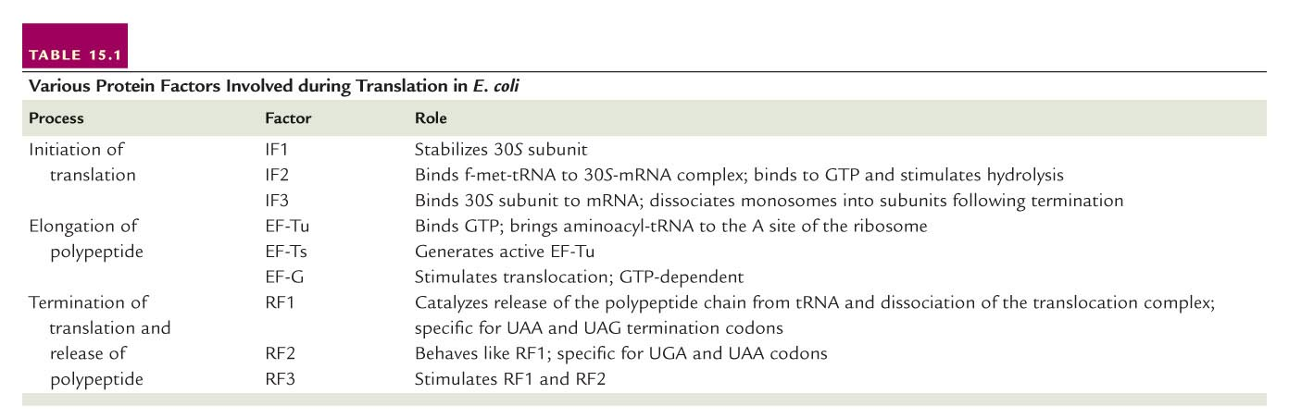
Translation, like transcription, requires accessory proteins to assist at each step.
Table 15.1
Notes:
Table 15-1 Various Protein Factors Involved during Translation in E. Coli

Slide 31
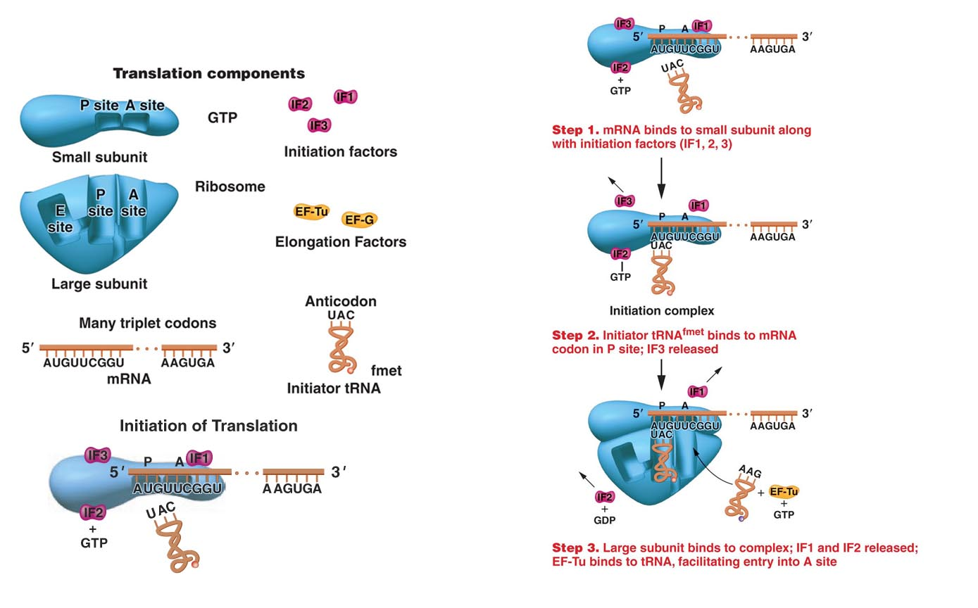
Figure 15.6
Notes:
Figure 15-6 Initiation of translation. The components are depicted at the left.

Slide 32
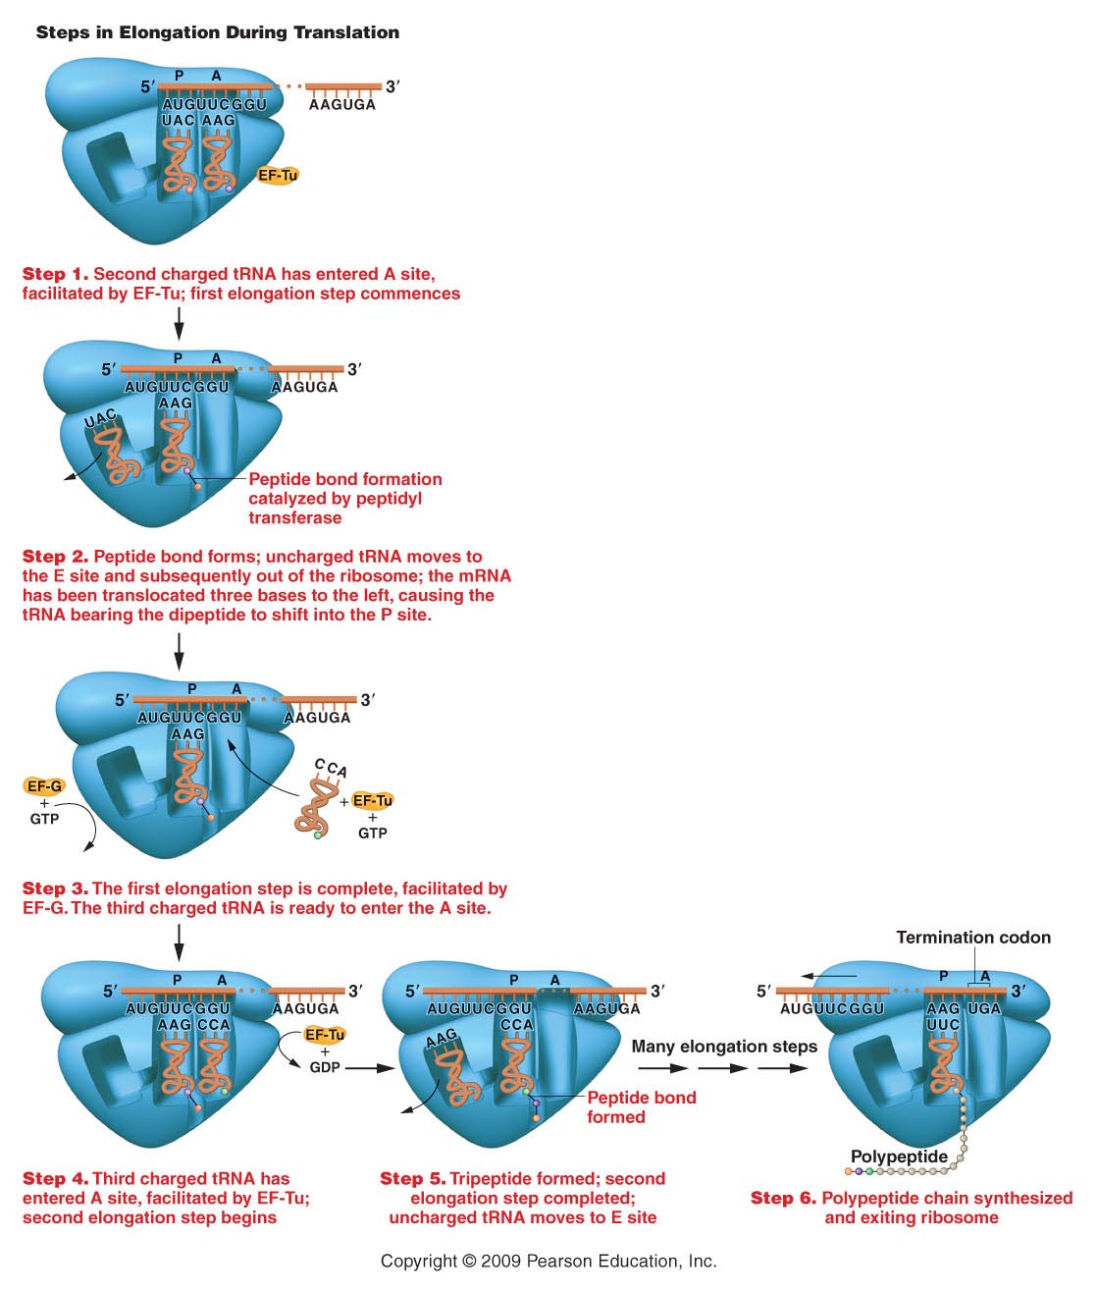
Figure 15.7
Notes:
Figure 15-7 Elongation of the growing polypeptide chain during translation.

Slide 33
During elongation each new amino acid is linked to the growing protein chain by a covalent peptide bond. The peptide bond is actually catalyzed by RNA components of the ribosome! Additional evidence for ribozyme activity.

Slide 35
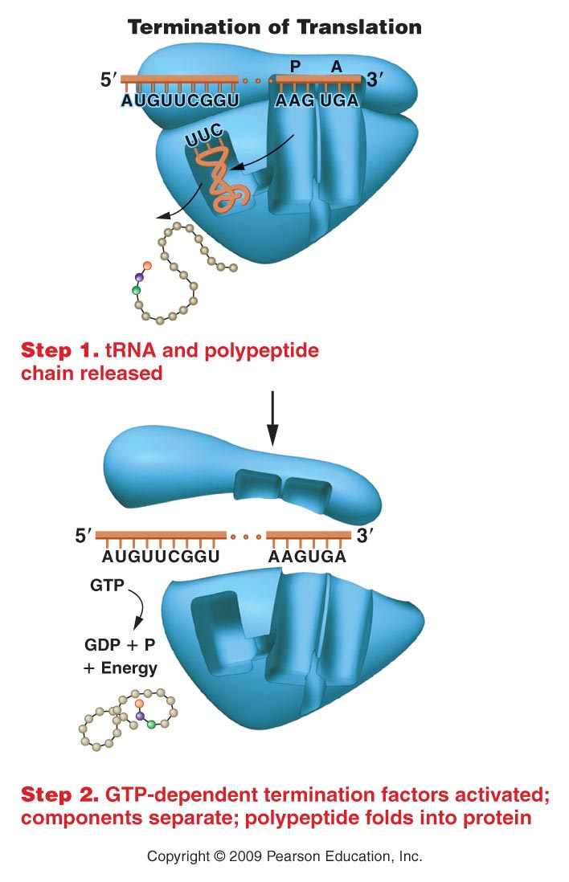
Figure 15.8
Notes:
Figure 15-8 Termination of the process of translation.

Slide 36
Just as each gene is transcribed many times, to produce many copies of mRNA from it, so too---each mRNA can be translated several times.
Translation can be initiated before termination of a previously initiated mRNA---ribosomes sort of jump on at a start codon as soon as it is unoccupied.

Slide 37
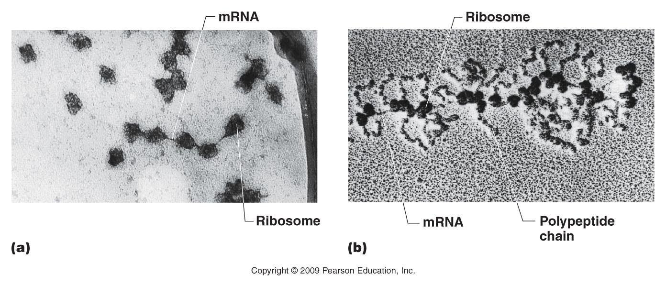
Figure 15.9
Notes:
Figure 15-9 Polyribosomes visualized under the electron microscope. Those in (a) were derived from rabbit reticulocytes engaged in the translation of hemoglobin mRNA and in (b) from salivary gland cells of the midgefly, Chironomus thummi. In (b), the nascent polypeptide chain is apparent as it emerges from each ribosome. Its length increases as translation proceeds from left (5) to right (3) along the mRNA.

Slide 38
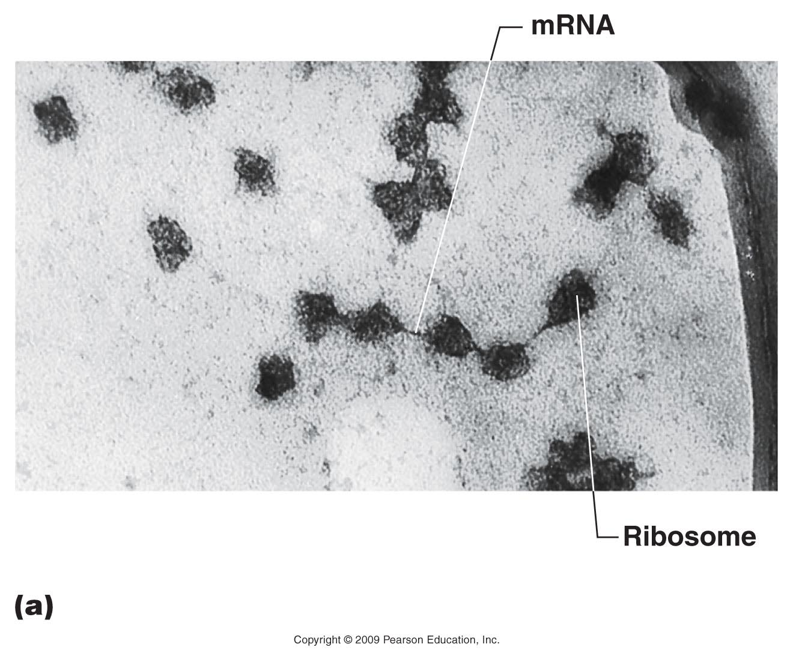
Figure 15.9a
Notes:
Figure 15-9a Polyribosomes visualized under the electron microscope. Those in (a) were derived from rabbit reticulocytes engaged in the translation of hemoglobin mRNA and in (b) from salivary gland cells of the midgefly, Chironomus thummi. In (b), the nascent polypeptide chain is apparent as it emerges from each ribosome. Its length increases as translation proceeds from left (5) to right (3) along the mRNA.

Slide 39
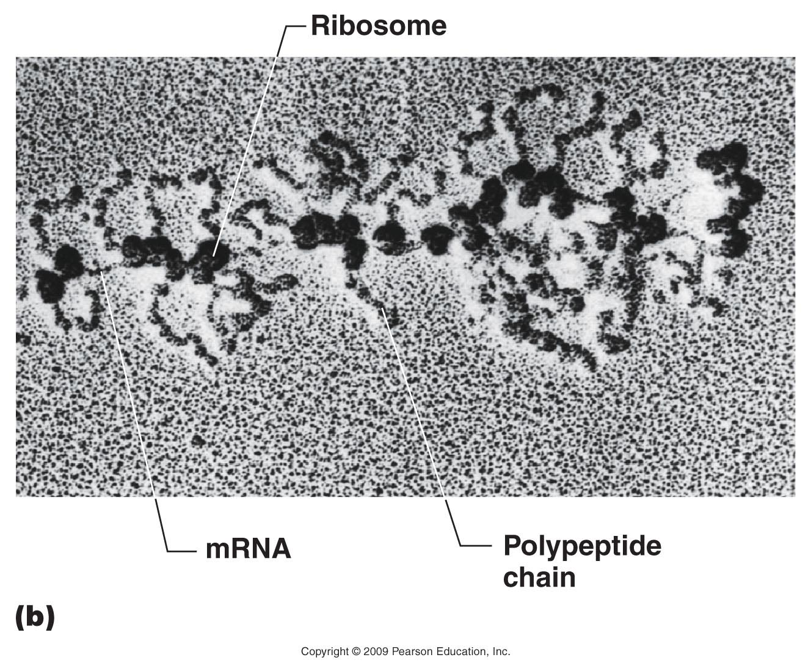
Figure 15.9b
Notes:
Figure 15-9b Polyribosomes visualized under the electron microscope. Those in (a) were derived from rabbit reticulocytes engaged in the translation of hemoglobin mRNA and in (b) from salivary gland cells of the midgefly, Chironomus thummi. In (b), the nascent polypeptide chain is apparent as it emerges from each ribosome. Its length increases as translation proceeds from left (5) to right (3) along the mRNA.

Slide 40
Good animations
https://www.dnalc.org/resources/3d/15-translation-basic.html
https://www.dnalc.org/resources/3d/16-translation-advanced.html

